Slide 1
Loading data in Redshift - COPY

Slide 2
COPY
Loads data into a table from data files or from an Amazon DynamoDB table.
The files can be located in an Amazon Simple Storage Service (Amazon S3) bucket, an Amazon EMR cluster,
or a remote host that is accessed using a Secure Shell (SSH) connection.

Slide 3
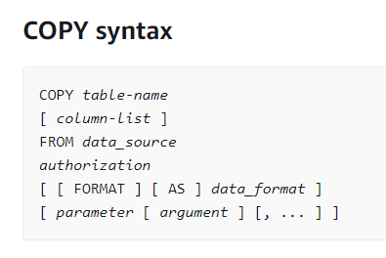
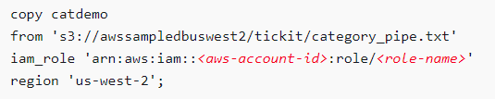
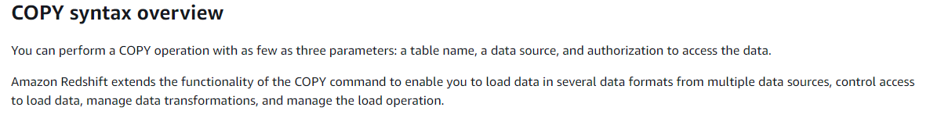

Slide 4
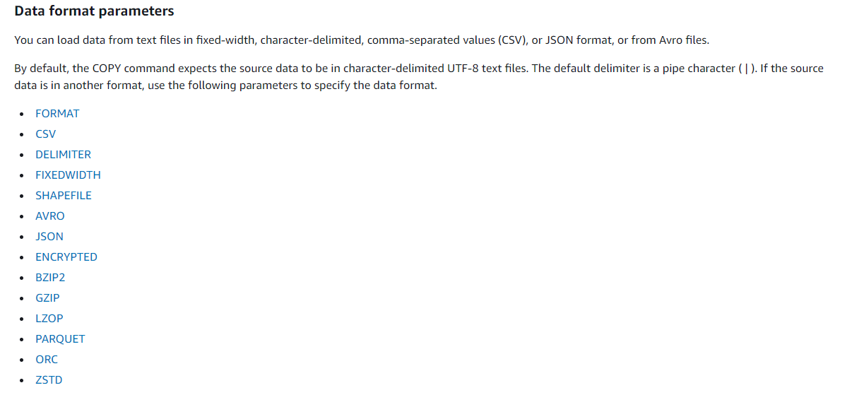

Slide 5
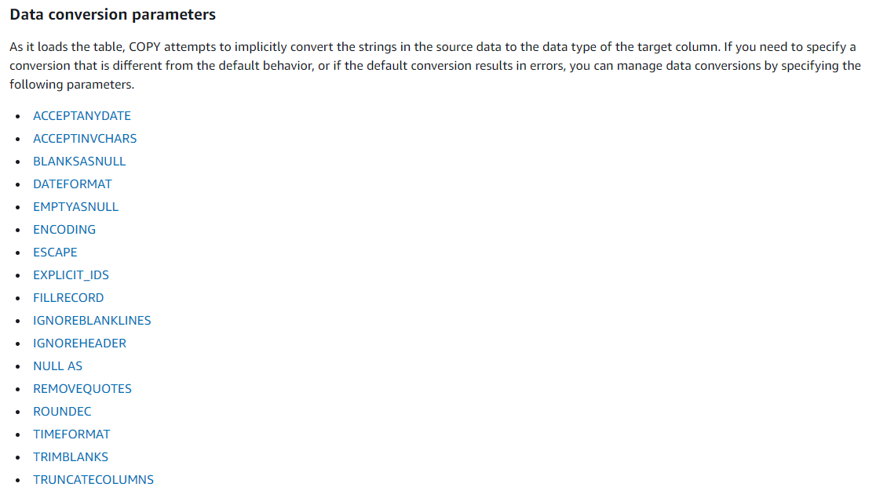

Slide 6
Data load operations
COMPROWS numrows
Specifies the number of rows to be used as the sample size for compression analysis.
The analysis is run on rows from each data slice.
For example, if you specify COMPROWS 1000000 (1,000,000) and the system contains four total slices,
no more than 250,000 rows for each slice are read and analyzed.
COMPUPDATE [ PRESET | { ON | TRUE } | { OFF | FALSE } ]
Controls whether compression encodings are automatically applied during a COPY.
Columns that are defined as sort keys are assigned RAW compression.
Columns that are defined as BOOLEAN, REAL, or DOUBLE PRECISION data types are assigned RAW compression.
Columns that are defined as SMALLINT, INTEGER, BIGINT, DECIMAL, DATE, TIMESTAMP, or TIMESTAMPTZ
are assigned AZ64 compression.
Columns that are defined as CHAR or VARCHAR are assigned LZO compression.
IGNOREALLERRORS
You can specify this option to ignore all errors that occur during the load operation.

Slide 7
Data load operations
MAXERROR [AS] error_count
If the load returns the error_count number of errors or greater, the load fails. If the load returns fewer errors,
it continues and returns an INFO message that states the number of rows
that could not be loaded. Use this parameter to allow loads to continue when certain rows fail to load into the table
because of formatting errors or other inconsistencies in the data.
Set this value to 0 or 1 if you want the load to fail as soon as the first error occurs. The AS keyword is optional.
The MAXERROR default value is 0 and the limit is 100000.
NOLOAD
Checks the validity of the data file without actually loading the data.
Use the NOLOAD parameter to make sure that your data file loads without any errors before running the actual
data load.
Running COPY with the NOLOAD parameter is much faster than loading the data because it only parses the files.
STATUPDATE [ { ON | TRUE } | { OFF | FALSE } ]
Governs automatic computation and refresh of optimizer statistics at the end of a successful COPY command.
By default, if the STATUPDATE parameter isn't used, statistics are updated automatically if the table is initially empty.

Slide 8
Export data from Redshift - UNLOAD

Slide 9
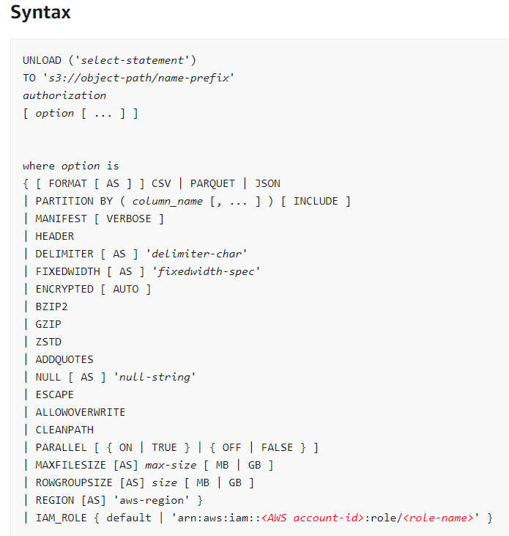
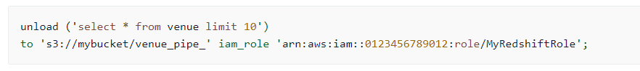
UNLOAD
Unloads the result of a query to one or more text, JSON, or Apache Parquet files on Amazon S3, using Amazon S3 server-side encryption (SSE-S3). You can also specify server-side encryption with an AWS Key Management Service key (SSE-KMS) or client-side encryption with a customer managed key.

Slide 10
PARTITION BY ( column_name [, ... ] ) [INCLUDE]
Specifies the partition keys for the unload operation.
UNLOAD automatically partitions output files into partition folders based on the partition key values
For example, a Parquet file that belongs to the partition year 2019 and the month September
has the following prefix: s3://my_bucket_name/my_prefix/year=2019/month=September/000.parquet.
MANIFEST [ VERBOSE ]
Creates a manifest file that explicitly lists details for the data files that are created by the UNLOAD process.
The manifest is a text file in JSON format that lists the URL of each file that was written to Amazon S3.
If MANIFEST is specified with the VERBOSE option, the manifest includes the following details:
The column names and data types, and for CHAR, VARCHAR, or NUMERIC data types, dimensions for each column.
For CHAR and VARCHAR data types, the dimension is the length. For a DECIMAL or NUMERIC data type, the dimensions are precision and scale.
The row count unloaded to each file. If the HEADER option is specified, the row count includes the header line.
The total file size of all files unloaded and the total row count unloaded to all files.
If the HEADER option is specified, the row count includes the header lines.
The author. Author is always "Amazon Redshift".

Slide 11
HEADER
Adds a header line containing column names at the top of each output file.
Text transformation options, such as CSV, DELIMITER, ADDQUOTES, and ESCAPE, also apply to the header line. You can't use HEADER with FIXEDWIDTH.
DELIMITER AS 'delimiter_character'
Specifies a single ASCII character that is used to separate fields in the output file, such as a pipe character ( | ), a comma ( , ), or a tab ( \t ).
The default delimiter for text files is a pipe character.
The default delimiter for CSV files is a comma character.
The AS keyword is optional. You can't use DELIMITER with FIXEDWIDTH.
If the data contains the delimiter character, you need to specify the ESCAPE option to escape the delimiter,
or use ADDQUOTES to enclose the data in double quotation marks. Alternatively, specify a delimiter that isn't contained in the data.
FIXEDWIDTH 'fixedwidth_spec'
Unloads the data to a file where each column width is a fixed length, rather than separated by a delimiter.
The fixedwidth_spec is a string that specifies the number of columns and the width of the columns.
The AS keyword is optional. Because FIXEDWIDTH doesn't truncate data, the specification for each column in the UNLOAD statement
needs to be at least as long as the length of the longest entry for that column.

Slide 12
IAM_ROLE { default | 'arn:aws:iam::<AWS account-id>:role/<role-name>'
Use the default keyword to have Amazon Redshift use the IAM role that is set as default and associated with the cluster when the UNLOAD command runs.
MAXFILESIZE [AS] max-size [ MB | GB ]
Specifies the maximum size of files that UNLOAD creates in Amazon S3. Specify a decimal value between 5 MB and 6.2 GB. The AS keyword is optional.
The default unit is MB. If MAXFILESIZE isn't specified, the default maximum file size is 6.2 GB. The size of the manifest file, if one is used, isn't affected by MAXFILESIZE.
ROWGROUPSIZE [AS] size [ MB | GB ]
Specifies the size of row groups. Choosing a larger size can reduce the number of row groups, reducing the amount of network communication.
Specify an integer value between 32 MB and 128 MB. The AS keyword is optional. The default unit is MB.
ALLOWOVERWRITE
By default, UNLOAD fails if it finds files that it would possibly overwrite. If ALLOWOVERWRITE is specified, UNLOAD overwrites existing files, including the manifest file.
CLEANPATH
The CLEANPATH option removes existing files located in the Amazon S3 path specified in the TO clause before unloading files to the specified location.

Slide 13
BZIP2
Unloads data to one or more bzip2-compressed files per slice. Each resulting file is appended with a .bz2 extension.
GZIP
Unloads data to one or more gzip-compressed files per slice. Each resulting file is appended with a .gz extension.
ZSTD
Unloads data to one or more Zstandard-compressed files per slice. Each resulting file is appended with a .zst extension.
ADDQUOTES
Places quotation marks around each unloaded data field, so that Amazon Redshift can unload data values that contain the delimiter itself.
For example, if the delimiter is a comma, you could unload and reload the following data successfully:
"1","Hello, World"

Slide 14
Concurrency scaling in Redshift

Slide 15
With the Concurrency Scaling feature, you can support virtually unlimited concurrent users and concurrent queries, with consistently fast query performance.
When you turn on concurrency scaling, Amazon Redshift automatically adds additional cluster capacity to process an increase in both read and write queries.
Users see the most current data, whether the queries run on the main cluster or a concurrency-scaling cluster.
You manage which queries are sent to the concurrency-scaling cluster by configuring WLM queues. When you turn on concurrency scaling, eligible queries are sent to the concurrency-scaling cluster instead of waiting in a queue.

Slide 16
